Slide 1







Job Openings
Sipho Ledwaba
20 November 2023

Slide 2



CONTENTS
Executive Summary
Introduction
Methodology
Results
Visualization – Charts
Dashboard
Discussion
Findings & Implications
Conclusion
Appendix

Slide 3

EXECUTIVE SUMMARY
The project focuses on analysing the Stack Overflow Developer Survey 2019 subset.
Rigorous data wrangling ensured dataset integrity, including removing duplicates and handling missing values.
Current Technology Usage Dashboard includes:
Top 10 Languages (Bar Chart): Highlights prevalent programming languages among developers.
Top 10 Databases (Column Chart): Visualizes popular databases used by developers.
Platforms and WebFrames (Word Cloud and Hierarchy Bubble Chart): Offers insights into platform diversity and web framework preferences.
Future Technology Trends Dashboard includes:
Top 10 Languages and Databases (Bar and Column Charts): Anticipates language and database trends for the upcoming year.
Desired Platforms and WebFrames (TreeMap and Hierarchy Bubble Chart): Visualizes developers' future technological aspirations.
Demographics Dashboard
Gender Distribution (Pie Chart): Provides an overview of gender diversity among respondents.
Respondent Distribution by Countries (Map Chart): Geographically represents the survey’s global reach.
Age Distribution (Line Chart): Visualizes respondent age demographics.
Gender and Education Intersection (Stacked Bar Chart): Explores educational backgrounds across gender categories.
The project delivers comprehensive insights into current technology trends, anticipates future developments, and explores the demographic landscape of software professionals using visualisations crafted through Cognos Dashboard Embedded (CDE).

Slide 4

INTRODUCTION
This capstone project delves into the Stack Overflow Developer Survey 2019 subset, aiming to extract meaningful insights from the global software development landscape. The analysis is structured around key focal points, emphasising precision and clarity.
Our exploration begins with a meticulous data wrangling process, ensuring the integrity of the dataset. This involves identifying and removing duplicates and addressing missing values. The project unfolds across three dashboards: Current Technology Usage, Future Technology Trends, and Demographics, each dedicated to distinct facets of the developer survey.
The Current Technology Usage Dashboard illuminates prevailing trends, showcasing the top programming languages, databases, platforms, and web frameworks through insightful visualisations.
Transitioning to the Future Technology Trends Dashboard, we anticipate the upcoming year's technological landscape, visualising developers' aspirations for languages, databases, platforms, and web frameworks.
Detailed attention is given to language and database preferences, offering nuanced perspectives on industry trends.
We leverage advanced chart types such as tree maps and hierarchy bubble charts to comprehensively understand developers' evolving preferences.
The analysis culminates with the Demographics Dashboard, unveiling valuable insights into the composition of the developer community. From gender distribution and global respondent locations to age demographics and educational backgrounds, this dashboard paints a holistic picture of the survey participants.
Gender classification provides a snapshot of diversity within the developer community.
Geographical representation and age distribution offer a nuanced understanding of the demographics.

Slide 5

METHODOLOGY
Data Wrangling and Cleaning:
Identified and removed duplicate rows to ensure data integrity.
Addressed missing values, guiding subsequent imputation or removal strategies.
Applied normalisation techniques for enhanced data consistency.
Dashboard Creation using Cognos Dashboard Embedded (CDE):
Crafted visualisations for Current Technology Usage, Future Trends, and Demographics.
Utilized Cognos Dashboard Embedded for dynamic and interactive dashboards.
Visualization and Interpretation:
Extracted insights through iterative analysis of dynamic visualisations.
Ensured each visualisation revealed meaningful patterns, trends, and correlations.
Tool and Technology Utilization:
Leveraged Cognos Dashboard Embedded for user-friendly and interactive data presentation.

Slide 6
RESULTS
Programming Languages:
The analysis of current technology usage reveals JavaScript, HTML/CSS, and SQL as the top three most learned programming languages this year. Anticipating future trends, the evaluation of desired languages for the next year uncovers PowerShell, C#, and HTML/CSS as the top three most preferred languages to learn.
Databases:
Examining current database preferences indicates MySQL, PostgreSQL, and Microsoft SQL Server as the top three most used databases this year. Looking forward, the analysis of desired databases for the next year highlights PostgreSQL, MongoDB, and Redis as the leading three most desired databases to use.
Dashboard Tabs:
Current Technology Usage Dashboard: Utilizing visualisations like bar charts and word clouds, this dashboard provides a comprehensive overview of current programming languages, databases, and critical technological ecosystems.
Future Technology Trends Dashboard: Utilizing tree maps and hierarchy bubble charts, this dashboard illuminates emerging trends in desired programming languages, databases, platforms, and web frameworks.
Demographics Dashboard: Unveiling gender distribution, global respondent locations, age demographics, and gender-education intersections.

Slide 7
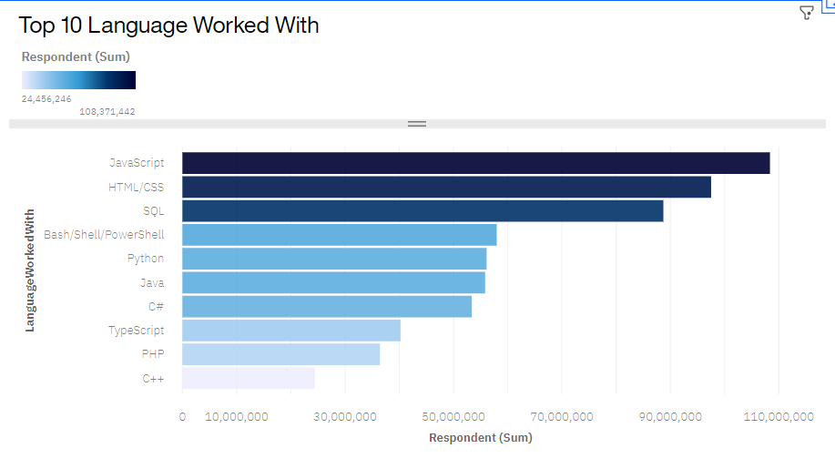
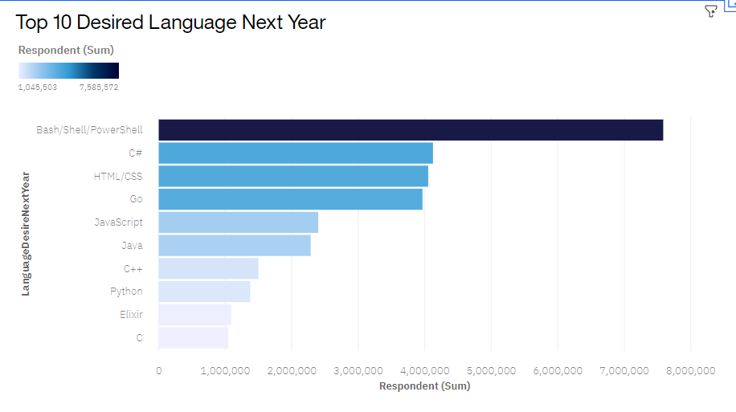
PROGRAMMING LANGUAGE TRENDS
Current Year
Next Year

Slide 8
PROGRAMMING LANGUAGE TRENDS - FINDINGS & IMPLICATIONS
Findings
JavaScript Dominates Learning: The analysis highlights JavaScript as the most learned programming language this year, underscoring its continued dominance in the learning landscape.
PowerShell Gains Ascent: Future trends reveal PowerShell's emergence as one of the top three most desired programming languages to learn, indicating its growing relevance and popularity.
HTML/CSS Remains Fundamental: HTML/CSS maintains its fundamental status, ranking among the top three most learned and desired languages, showcasing its ongoing importance in web development.
Implications
Full-Stack Development Emphasis: JavaScript's sustained dominance suggests a continued emphasis on full-stack development, where knowledge of both front-end and back-end technologies is crucial.
Growing Significance of PowerShell: The ascent of PowerShell in desired languages indicates an increasing need for automation and scripting, particularly in system administration and DevOps roles.
Enduring Relevance of Web Fundamentals: HTML/CSS's consistent presence underscores the enduring relevance of web fundamentals. Despite technological advancements, a strong foundation in web development basics remains essential.

Slide 9
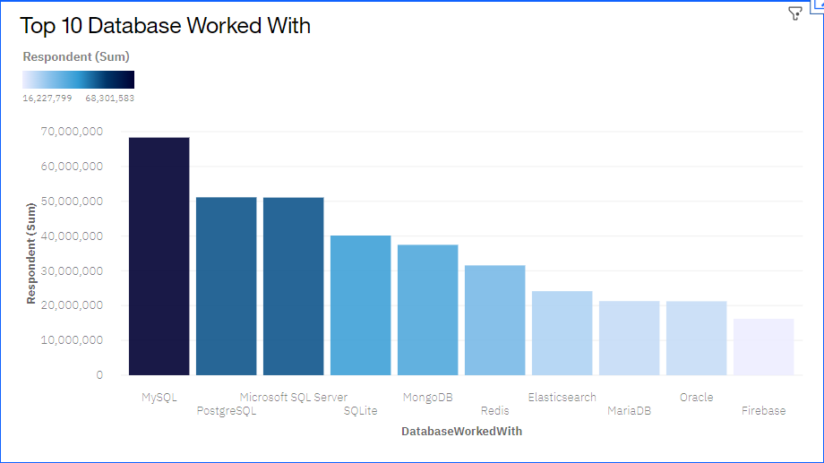
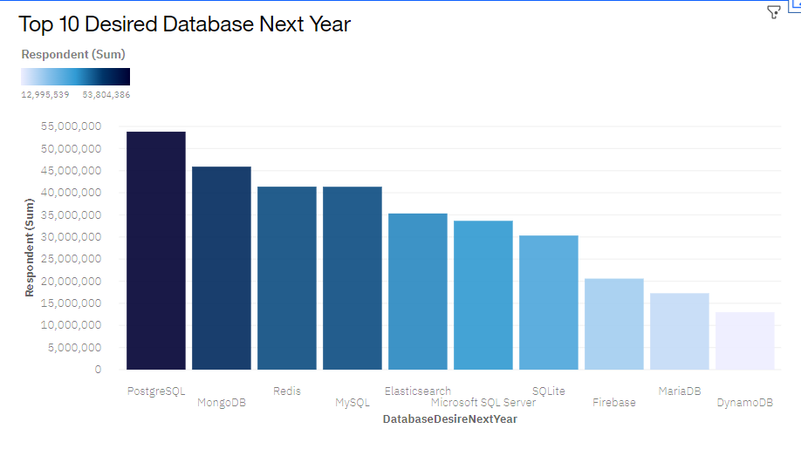
DATABASE TRENDS
Current Year
Next Year

Slide 10
DATABASE TRENDS - FINDINGS & IMPLICATIONS
Findings:
PostgreSQL Surges in Popularity: The analysis reveals a significant uptick in PostgreSQL usage, positioning it as one of the top three most-used databases this year.
MongoDB's Future Dominance: Future trends highlight MongoDB's prominence, emerging as one of the top three most desired databases for the following year.
MySQL Maintains Strong Presence: Despite the evolving landscape, MySQL maintains a robust presence, securing its position as one of the top three databases used this year.
Implications:
Shift Towards Open Source Solutions: The rise of PostgreSQL and MongoDB signals a broader industry shift towards open-source database solutions, potentially driven by factors like cost-effectiveness and community support.
Increasing Demand for NoSQL: MongoDB's anticipated dominance suggests a growing demand for NoSQL databases, reflecting the need for scalable and flexible data management solutions in future projects.
Continued Reliability of MySQL: MySQL's consistent usage indicates its enduring reliability, reassuring organisations and developers of its stability for various applications, from small-scale projects to large enterprises.

Slide 11

DASHBOARD
https://eu-gb.dataplatform.cloud.ibm.com/dashboards/4c2d5fc2-8506-40f3-b833-90813b8c6513/view/4e33b82c3e9613c575c5c4e407cd290e2833775cb3bb8a57d5837b495b342397f36b4794c82643088f475637f1e9125cce

Slide 12
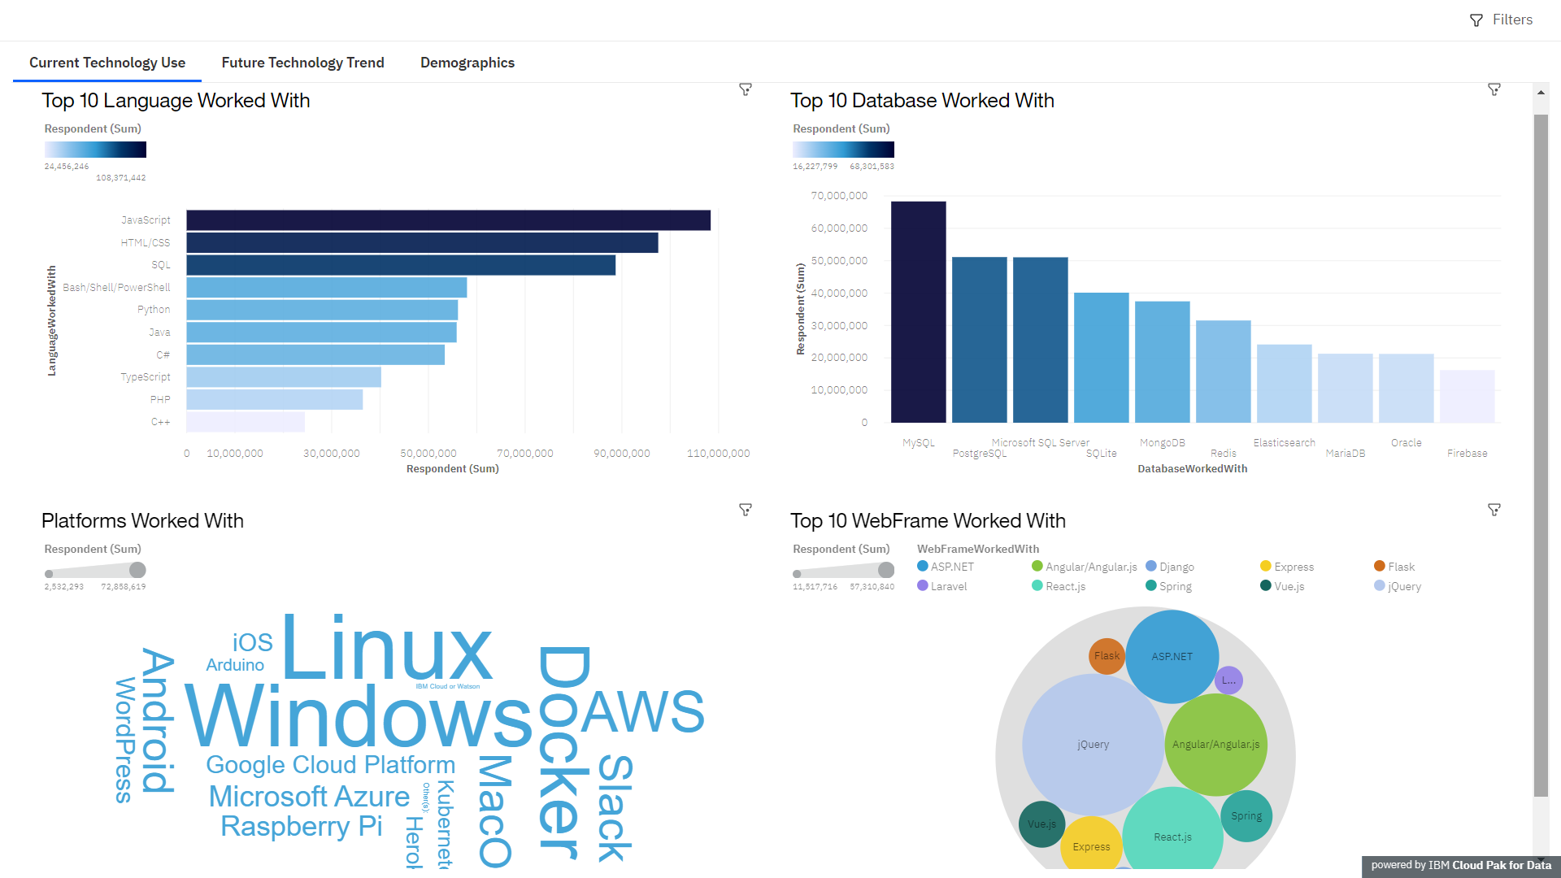
DASHBOARD TAB 1

Slide 13
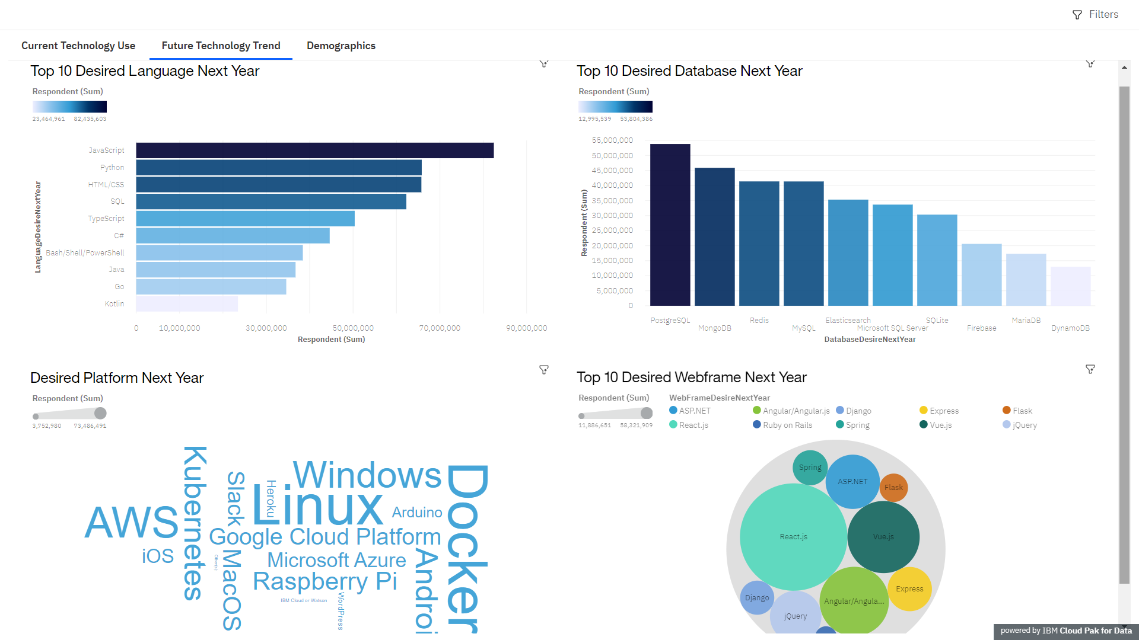
DASHBOARD TAB 2

Slide 14
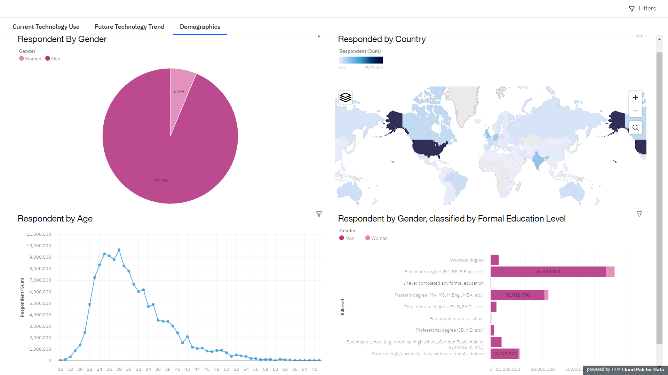
DASHBOARD TAB 3

Slide 15
DISCUSSION
1. Database Trends:
Shift to Open Source: PostgreSQL's rise signals a shift towards cost-effective, community-supported open-source databases.
NoSQL Demand: MongoDB's future dominance suggests a growing demand for flexible NoSQL solutions.
MySQL Reliability: MySQL's consistent presence highlights its reliability, maintaining relevance in various applications.
2. Programming Language Trends:
Full-Stack Emphasis: JavaScript's dominance underscores the importance of full-stack development skills.
PowerShell's Rise: PowerShell's popularity reflects a rising need for automation and scripting across domains.
Web Fundamentals Vital: HTML/CSS's enduring importance emphasises the timeless value of web development basics.
3. General Insights:
Adaptability Matters: The dynamic tech landscape requires adaptability for developers and organisations.
Balancing Tradition and Innovation: Striking a balance between established and emerging technologies is critical for effective development strategies.
In conclusion, these insights guide developers and organisations in navigating the evolving landscape of databases and programming languages.

Slide 16
OVERALL FINDINGS & IMPLICATIONS
Dynamic Technology Landscape:
Finding: The analysis underscores the dynamic nature of technology trends in databases and programming languages.
Implication: Developers and organisations must prioritise adaptability to navigate the evolving landscape effectively.
Diversity in Database Preferences:
Finding: The variety in database preferences, from open source to traditional choices, suggests a nuanced approach is crucial.
Implication: Organizations should assess the unique needs of their projects and consider a balanced mix of database technologies.
Full-Stack Proficiency in Demand:
Finding: Full-stack development skills, highlighted by JavaScript's dominance, are paramount in the current industry landscape.
Implication: Developers seeking to stay competitive should invest in front-end and back-end proficiency.
Automation and Scripting's Rising Relevance:
Finding: The ascent of PowerShell emphasises the growing importance of automation and scripting.
Implication: Developers and IT professionals should use automation tools to enhance efficiency.
Enduring Significance of Web Fundamentals:
Finding: HTML/CSS's consistent presence reaffirms the timeless importance of web development basics.
Implication: A strong foundation in web fundamentals remains a cornerstone for effective web development.
Balancing Tradition and Innovation:
Finding: The coexistence of established and emerging technologies stresses the need for a balanced development approach.
Implication: Striking a balance between tradition and innovation ensures well-rounded and effective software development strategies.
In summary, the findings highlight the need for adaptability, a nuanced approach to technology choices, and continuous skill development to thrive in the dynamic software development landscape.

Slide 17

CONCLUSION
Adaptability as a Core Competency:
The ever-evolving tech landscape emphasises adaptability as a core competency for developers and organisations. Staying flexible and responsive to changing trends is essential for sustained success.
Strategic Technology Choices:
Strategic technology choices are crucial. Organisations should carefully consider the diverse landscape of databases and programming languages, balancing tradition and innovation to meet the unique demands of their projects.
Continuous Skill Development:
Continuous skill development is critical for developers. The significance of full-stack proficiency, automation, and foundational web skills underscores the need for ongoing learning to stay competitive.
Holistic Development Strategies:
Holistic development strategies, considering current trends and future projections, ensure a comprehensive approach. Balancing diverse technologies and embracing emerging tools positions developers and organisations for long-term success.
In summary, the dynamic nature of technology trends necessitates a proactive and strategic mindset, where adaptability, informed choices, continuous learning, and holistic strategies pave the way for success in the ever-changing world of software development.

Slide 18

APPENDIX
The appendix includes Python scripts for analysis, and visualisations showcasing the technical aspects.
JOBs api\JOBs API PY.py
JOBs api\JOBs API SQL.py

Slide 19
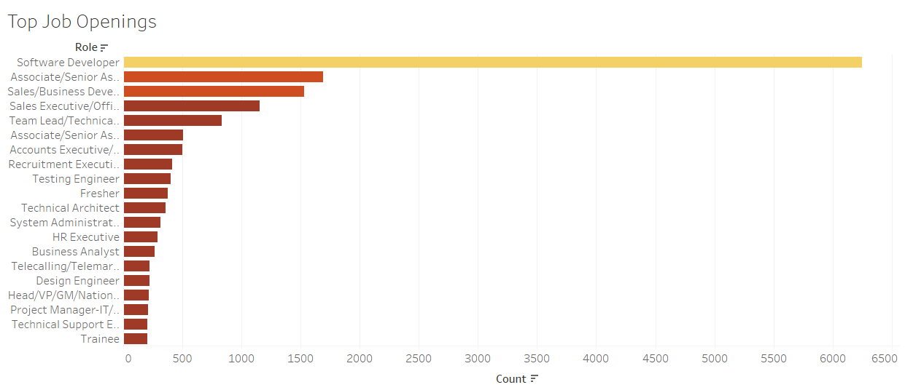
JOB POSTINGS

Slide 20
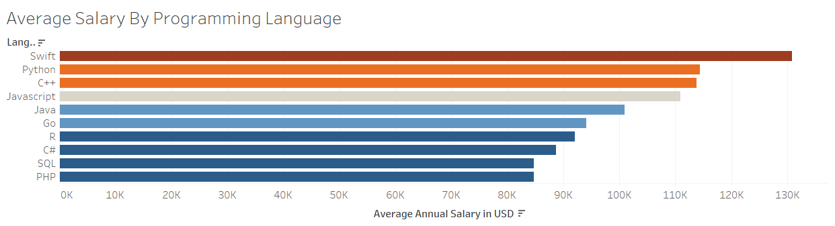
POPULAR LANGUAGES

Slide 21
THANK YOU

